Slide 1
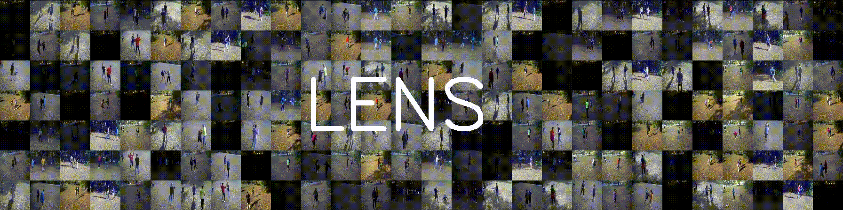
LENS
Low-light Environment Neural Surveillance
Henry Gridley, Kevin Hines, Noah Lichtenstein, John Nguyen, Michael Potter, Jacob Walsh
Advisor: Professor Bahram Shafai
Notes:
Kevin
add Shafai

Slide 2

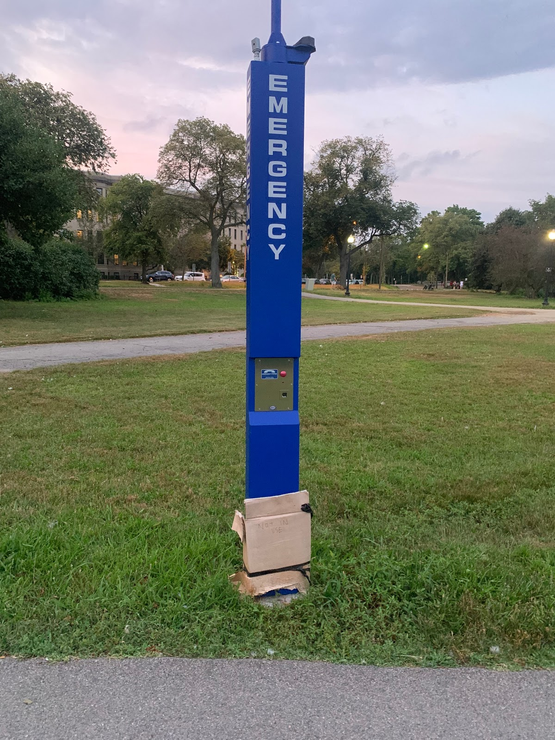
Problem
Strong correlation between criminal activity and dimly lit public spaces
Need for intelligent devices to augment police efforts
Reduce need for active police presence
Areas like parks, industrial complexes, private green spaces, etc. pose a problem for traditional surveillance mechanisms
CCTV only reactively identifies criminals
Blue light systems require active use
Notes:
Speaker: Kevin
Notes:
Areas like public parks are safe during the day but become dangerous at night
Currently, CCTV systems exists but only provide a REACTIVE solution to the problem
It is too costly to light them fully, or to have active presence during all hours of the night.
A police officer or security guard needs to be paid around the clock to either monitor the area, or the CCTV video - they could miss something occuring causing them to look back at video and waste more time.
Blue light systems require active participation by the victim, may not be possible

Slide 3
Our Solution
Camera footage is analyzed locally by a computer vision action-recognition model
Works in low light
Footage does not need to be manually viewed
Law Enforcement receive direct alerts to criminal activity in the area
Passive solution does not require victims to engage the system
Proactive solution, quicker response time
Notes:
Speaker: Jacob
Notes:
Does not need to be viewed 24/7 - run through action recognition neural net
Automatically alerts the police when a crime is detected - a passive solution
All of it encompassed in a simple to use mobile application that the local law enforcement will have access to.
App will allow law enforcement to take action based on what the complex neural nets detect.

Slide 4
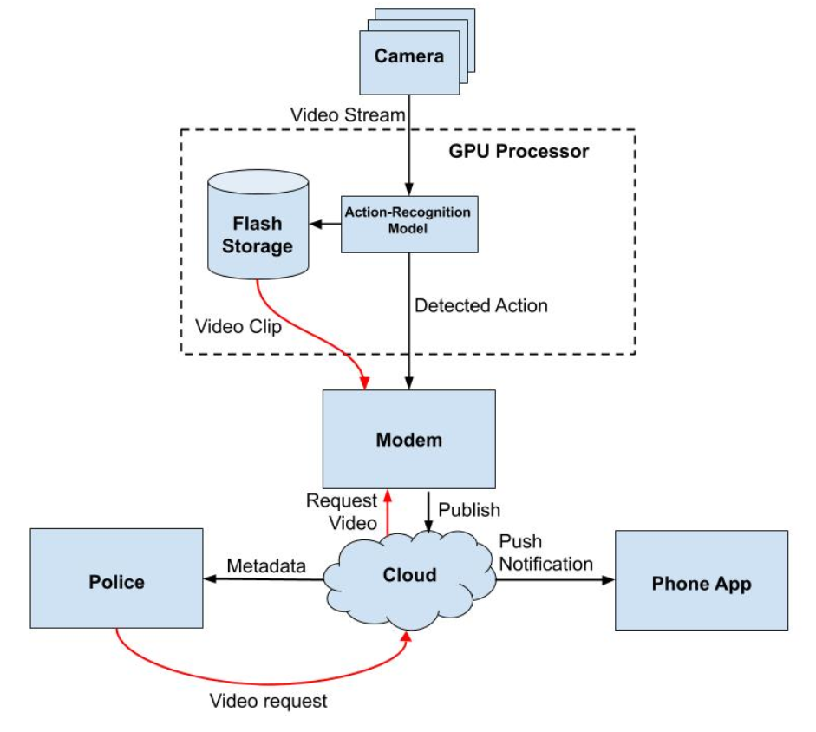
Approach
Hardware
Camera
GPU
Cloud
Databases
Serverless Computing
Mobile App
Computer Vision
Action recognition
Thresholding/postprocessing
Notes:
Speaker: Jacob

Slide 5
Hardware

Slide 6
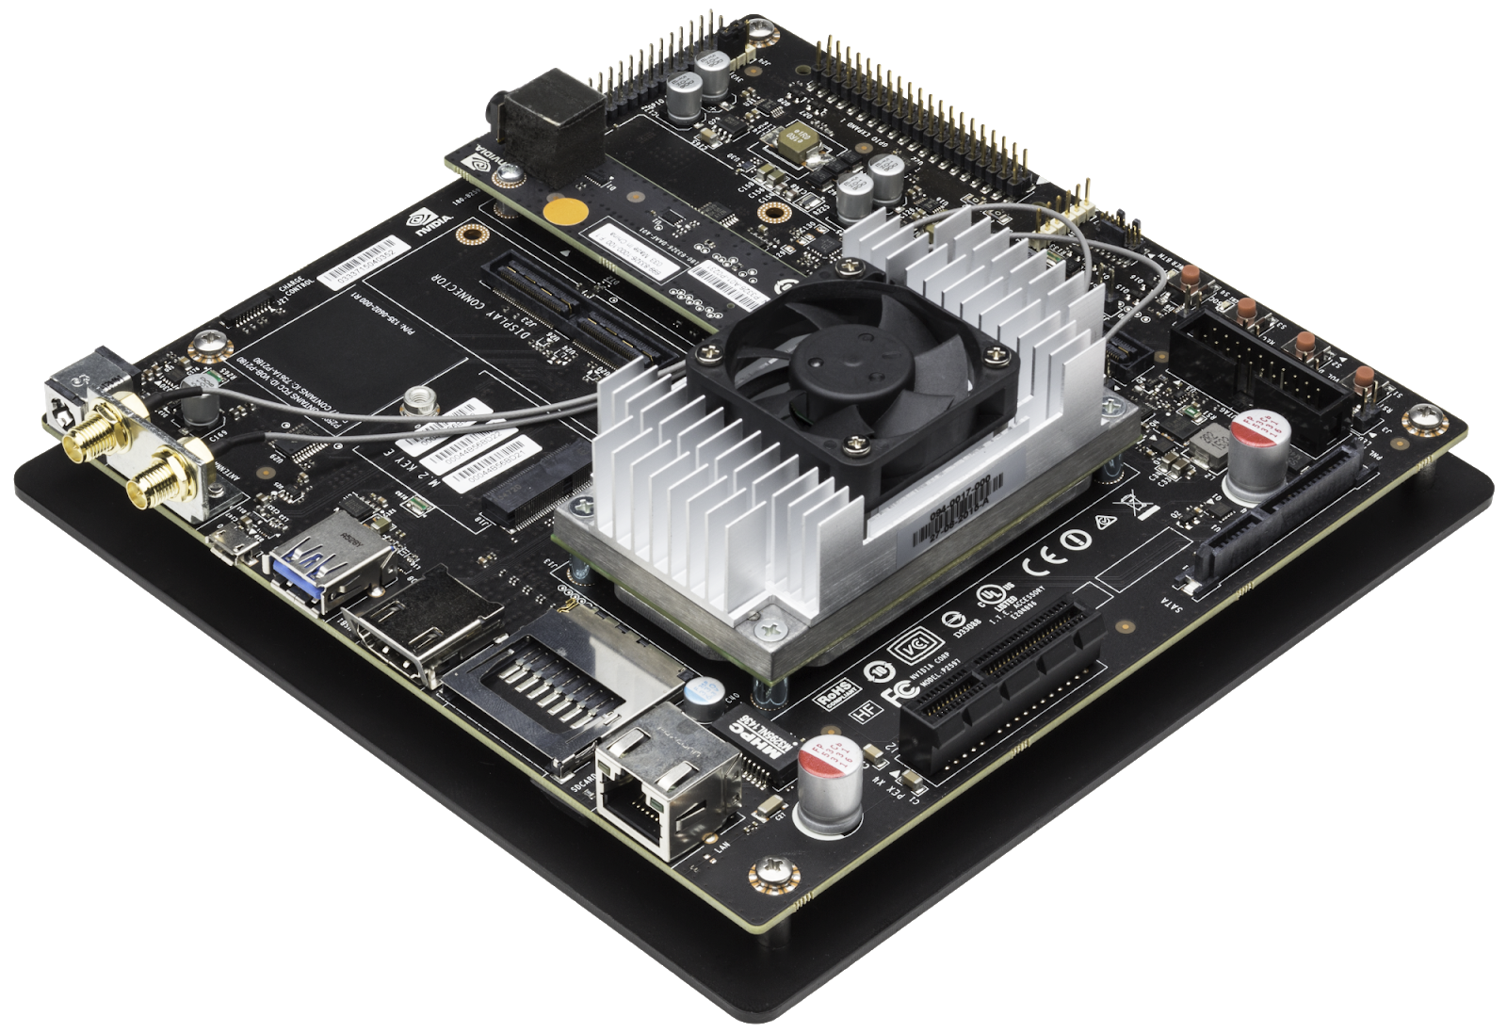
Compute Board
NVIDIA Jetson TX2- $300
CPU
ARM Cortex-A57 (quad-core) @ 2 GHz
NVIDIA Denver2 (dual-core) @ 2 GHz
GPU
256-core Pascal @ 1.3 GHz
Video capabilities
4Kp60, (3x) 4Kp30, (8x) 1080p30 Encoder
(2x) 4Kp60 Decoder
Network
802.11a/b/g/n/ac 2×2 867Mbps
Bluetooth 4.1
Notes:
Speaker: John

Slide 7
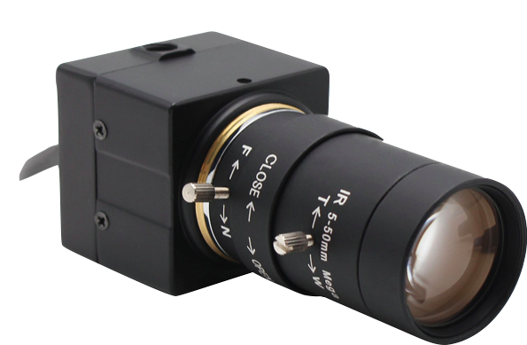
Low-Light Camera
ELP Sony IMX322- $70
Sensor
1/2.9’’ Sony IMX322 CMOS
Manual and auto image acquisition
Framerate
1920x1080 @ 30fps
1280x720 @ 60fps
Low-light capabilities
42dB SNR
86dB Dynamic Range
0.01 lux
Notes:
Speaker: John

Slide 8
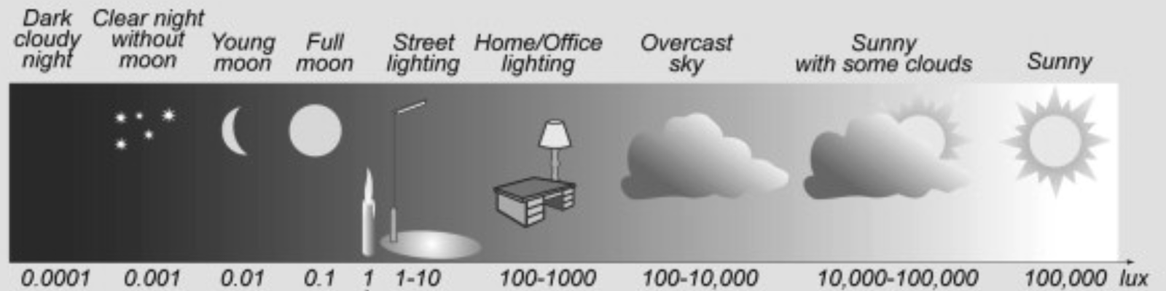
Lux
Notes:
Speaker: John
Notes:
Lux = lumens per square meter
Equivalent to ambient lighting with crescent moon

Slide 9
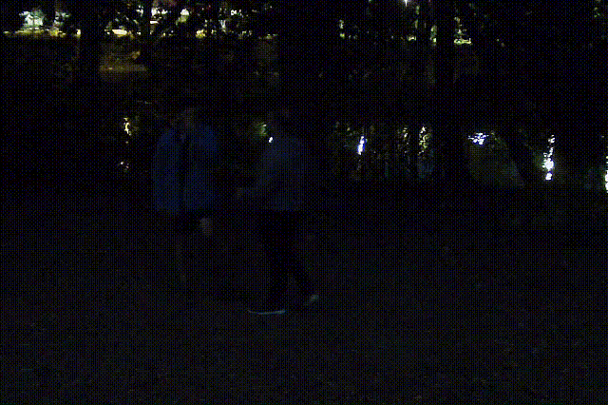
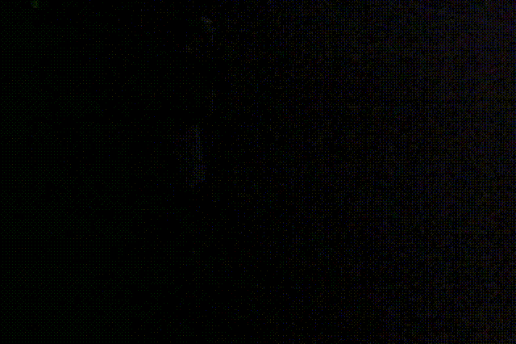
Camera Performance
Low Light Camera
Non-Low Light Camera
Notes:
Speaker: John

Slide 10
Cloud Architecture

Slide 11
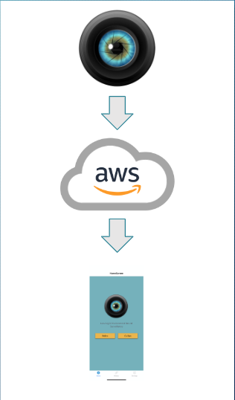
Device to Cloud
Model passes positive crime predictions to a local parsing and processing layer
Processing layer communicates crimes to cloud databases, and transmits requested videos to online storage
Law Enforcement view recent crime detections in police portal application
Citizens can opt-in to receive notifications when police determine a crime credible and dangerous
Notes:
Speaker: Noah

Slide 12
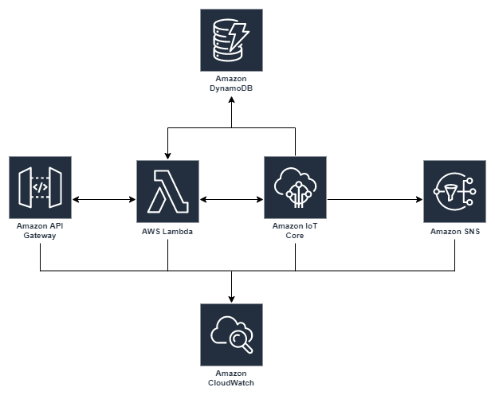
Amazon Web Services
Camera connects via MQTT to the IoT core which handles security, and communicates information to DynamoDB and S3
Apps connect via API Gateway, which provides access to the database
Law enforcement portal triggers SNS to send text message
Notes:
Speaker: Kevin (also maybe Noah)

Slide 13
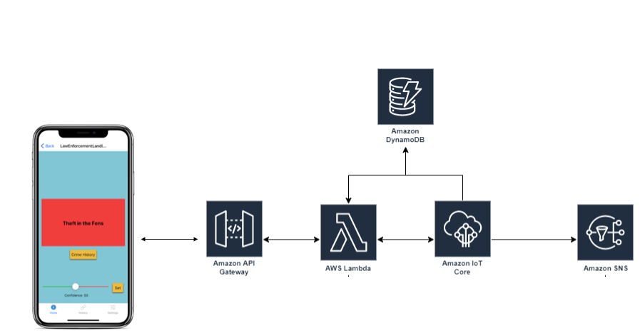
User Interface
Cross Platform Mobile App
React Native
Integrated with AWS backend
Separate law enforcement and civilian apps
Text notifications
Notes:
Speaker: Kevin
Notes:
Use API gateway as its main endpoint to the cloud
API gateway will filter into Lambda, S3, Simple Notification service and the database to serve the app over REST API

Slide 14
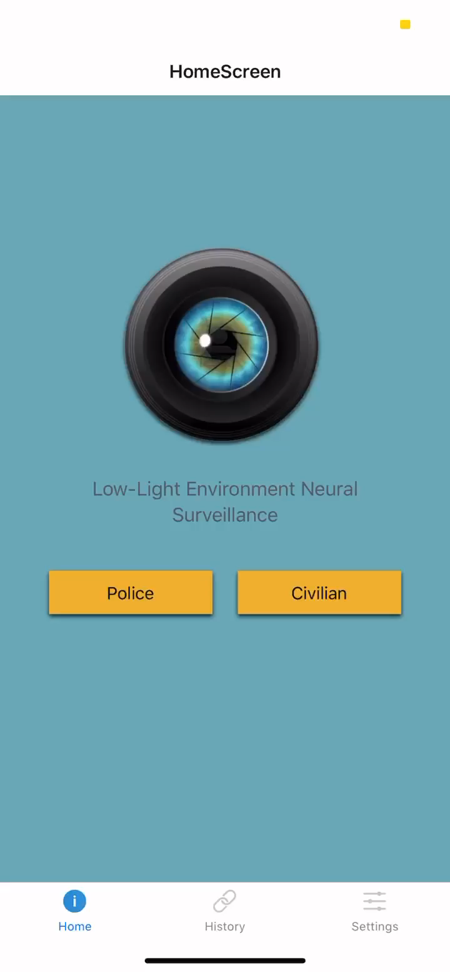
Notes:
Speaker: Kevin

Slide 15
Computer Vision

Slide 16
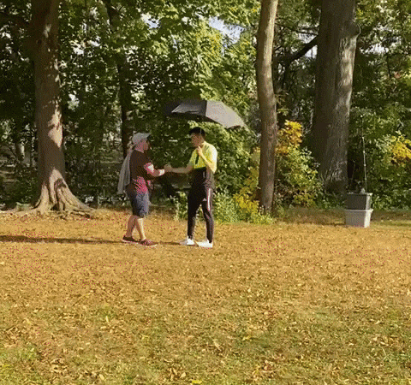
Data Collection
Notes:
Speaker: Henry

Slide 17
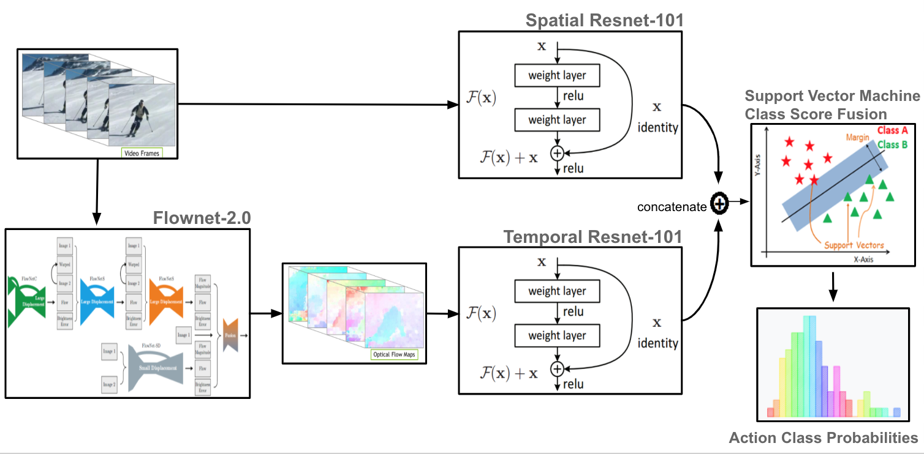
Network Architecture
Notes:
Speaker: Henry

Slide 18
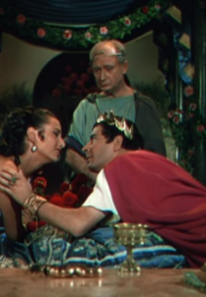
Optical Flow
Technique for recovering motion from images and video
Required for proper action understanding
Actions cannot exist at a single instance in time
Allows understanding of movement over time
Notes:
Speaker: Henry

Slide 19
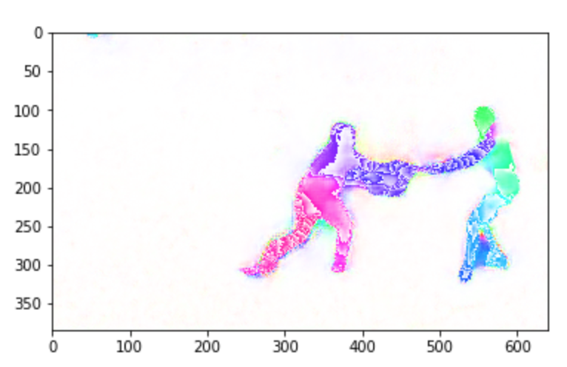
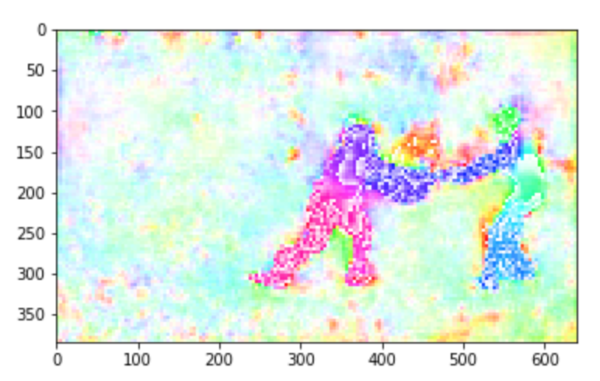
Optical Flow
High Accuracy, Low Framerate
Low Accuracy, High Framerate
Notes:
Speaker: Henry
Notes:
Color coded (HSV)

Slide 20
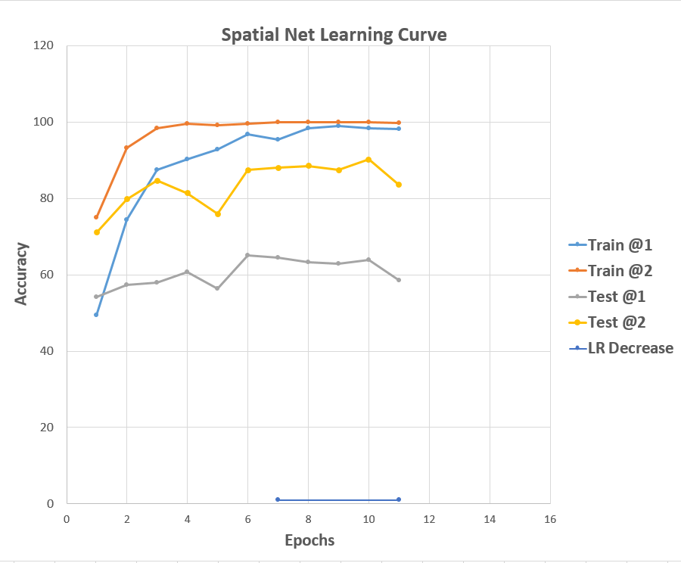
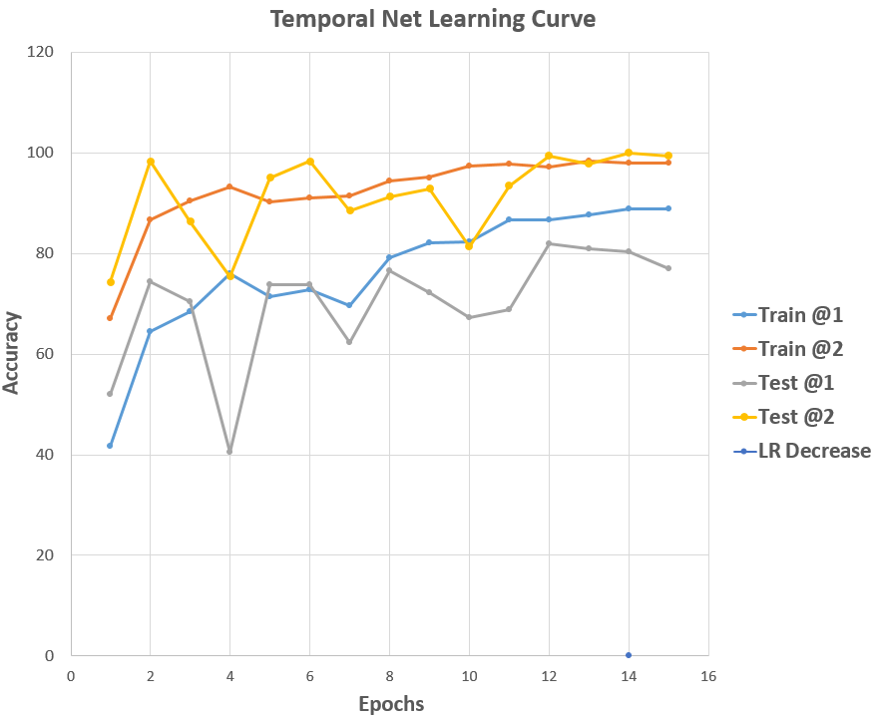
Training
Two-stream
Pretrained on ImageNet + UCF101
Fine-tuned on custom dataset
Results
Spatial: 71% accuracy
Temporal: 87% accuracy
Support Vector Machine (SVM)
Aggregate predictions from spatial and temporal predictions
Extremely long train time
Notes:
Speaker: Michael

Slide 21
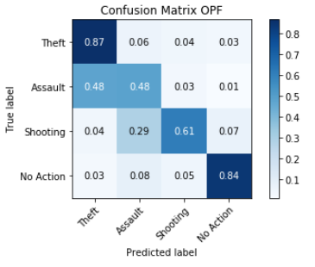
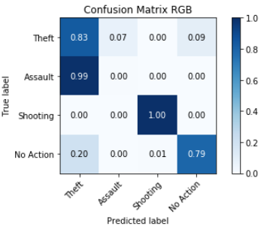
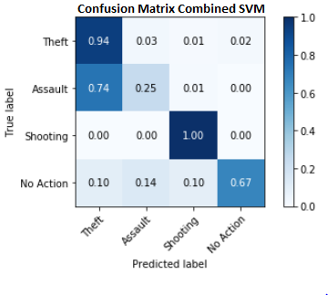
Results
Notes:
Speaker: Michael

Slide 22
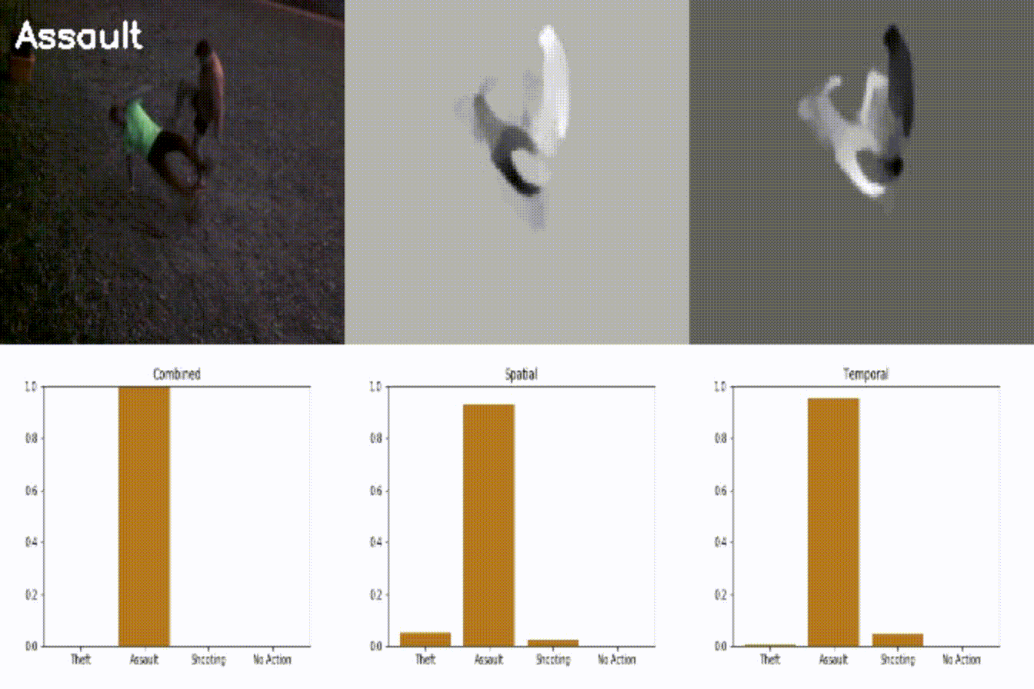
Results
Notes:
Speaker: Michael

Slide 23
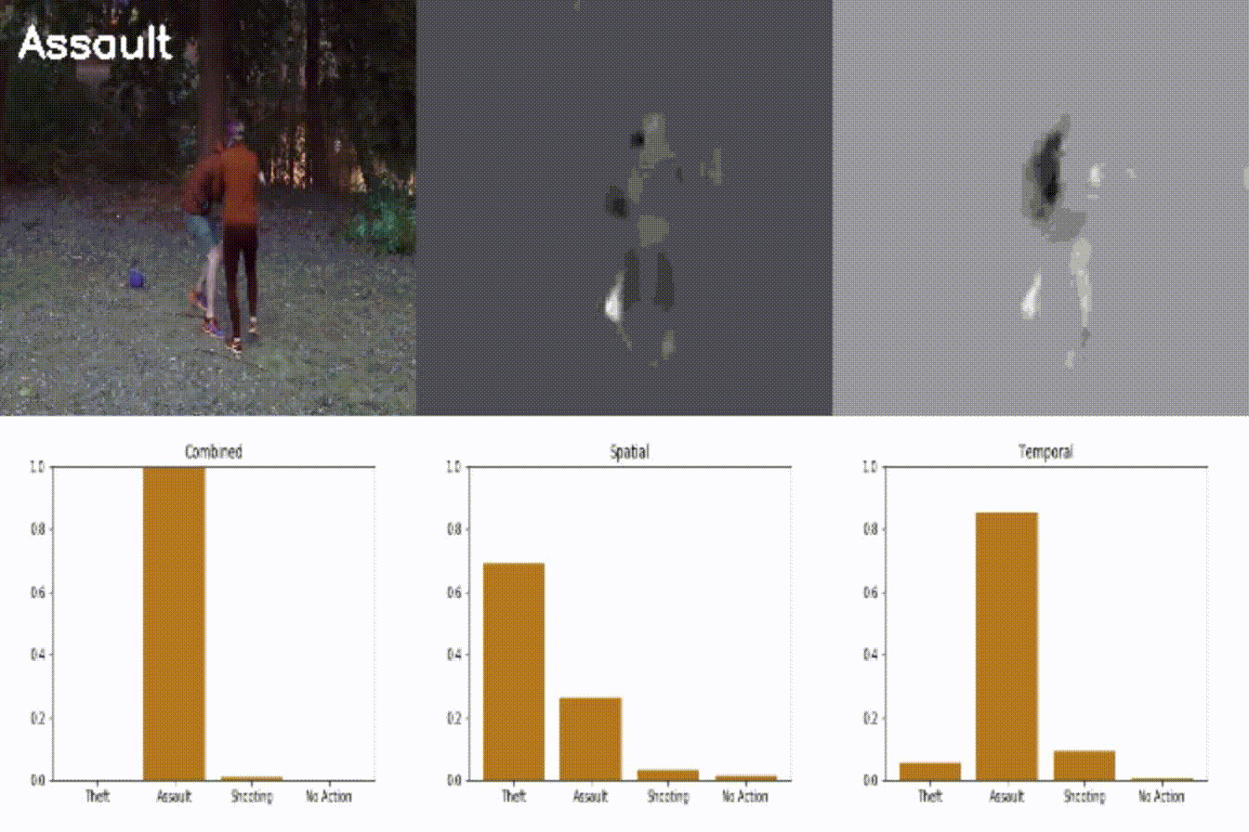
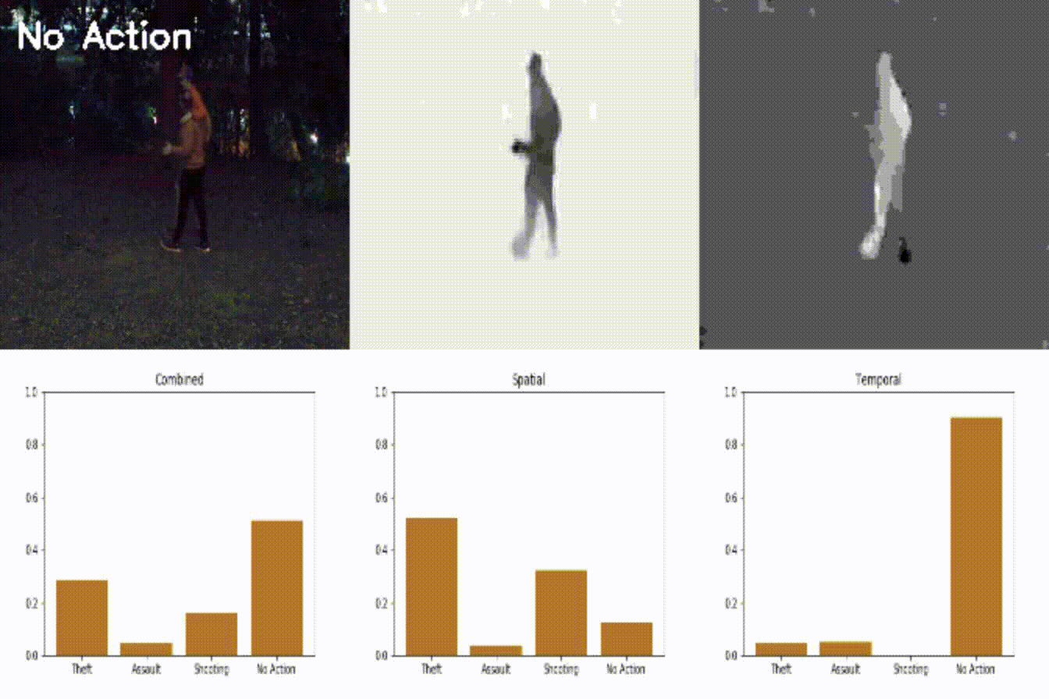
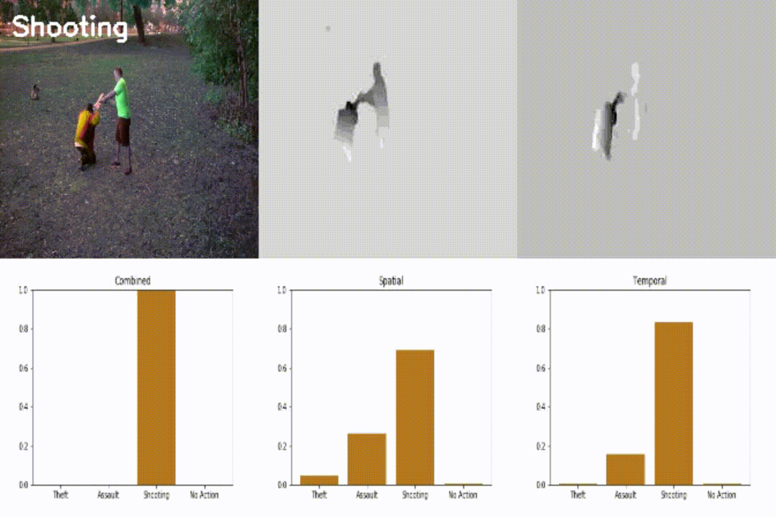
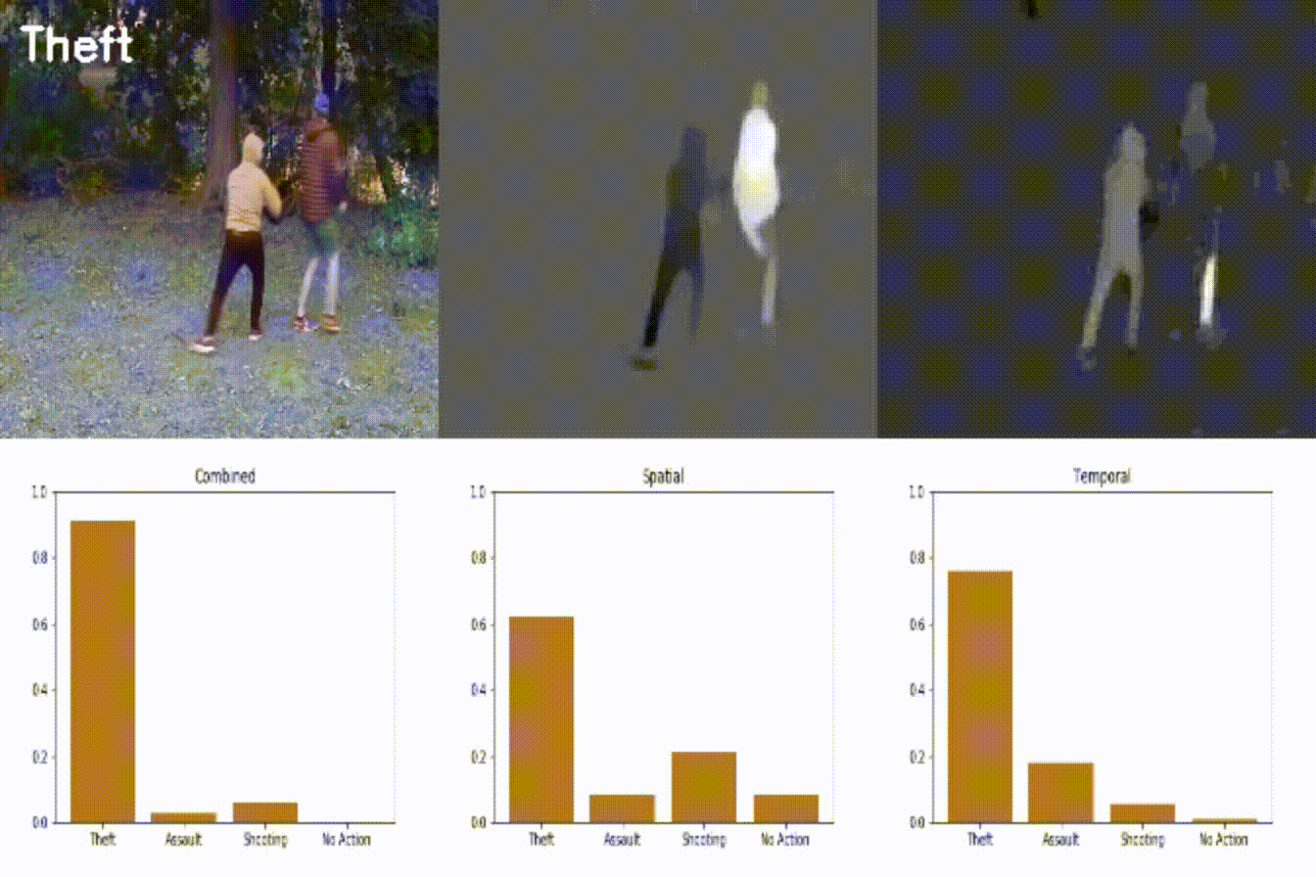
Light Environment
Notes:
Speaker: Michael

Slide 24
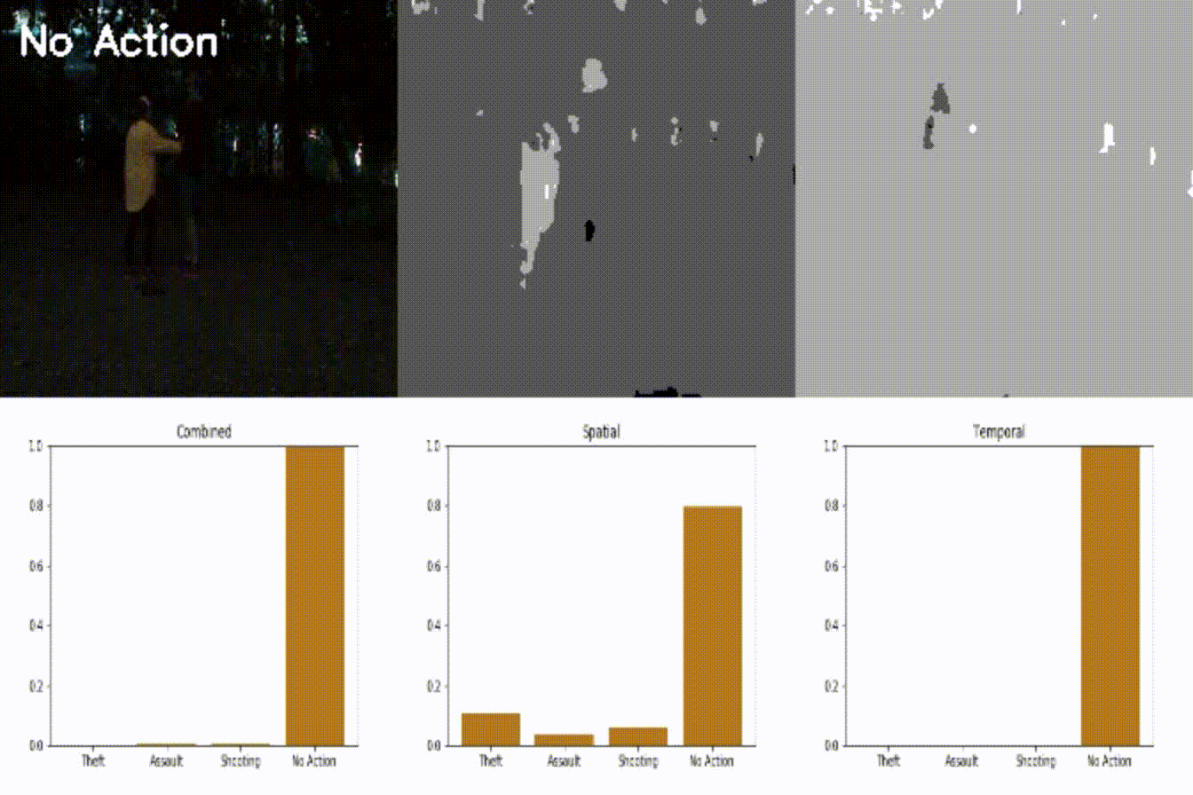
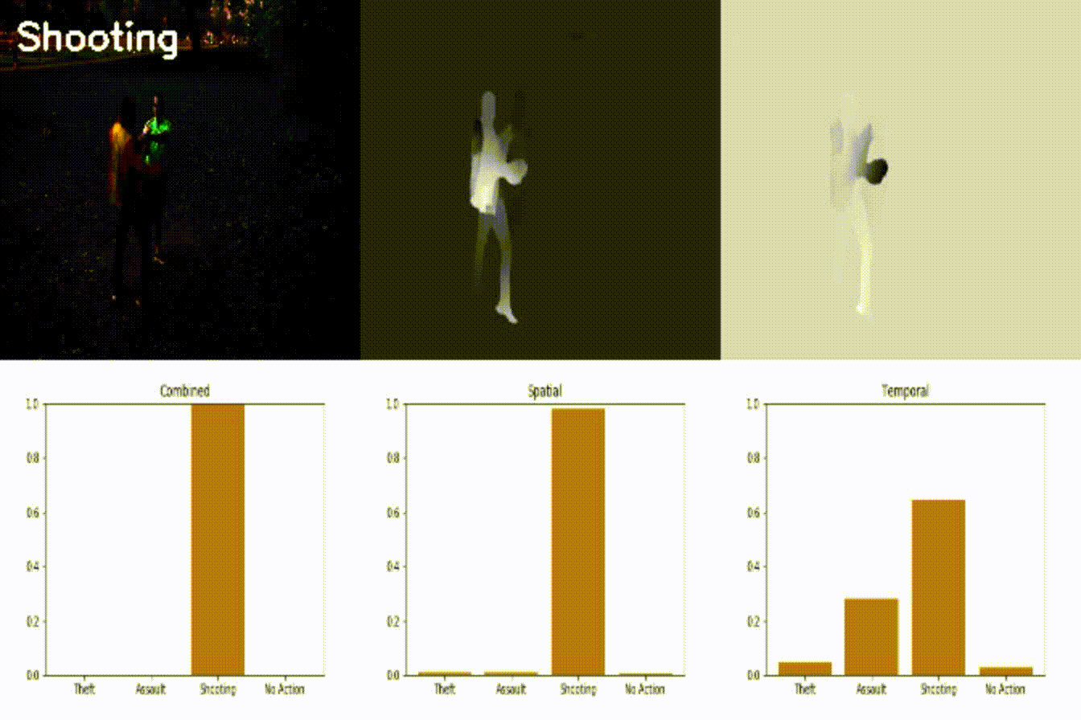
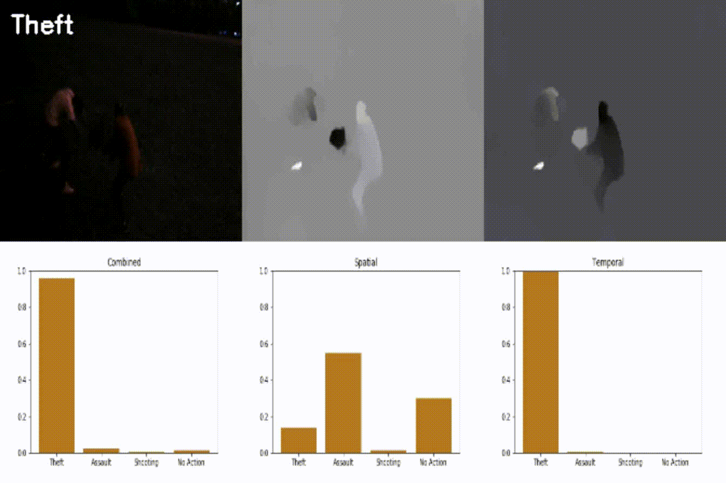
U
V
Dark Environment
Notes:
Speaker: Michael

Slide 25
Cost Benefit Analysis
Criteria | Traditional Security | LENS
Initial Cost | $0 | $370 (per camera)
Monthly Cost | $8,300 ($12/hour) | $1 (per camera)
5-Year Total | $500,000 | $430
Attention | Divided | Undivided
Notes:
Speaker: Kevin

